Slide 1




Introduction To Image Analysis
Daniel Waiger
HUJI-CSI
Notes:
1. "Welcome to our introductory workshop on Image Analysis. Today, we are gathered here to explore the intriguing world of image analysis. This workshop will introduce you to the fundamental aspects of this discipline and provide you with the skills you need to start your journey in this field."
2. "Image analysis plays a crucial role in various fields such as healthcare, computer vision, artificial intelligence, and many more. By transforming images into numerical data, we can extract significant information that can help in decision-making processes, research studies, and advancements in technology. Whether it's analyzing medical scans or images of distant galaxies, image analysis provides the tools to understand and interpret the world around us."
3. "In this workshop, we will delve into the basics of image processing. This involves understanding different types of images—binary, grayscale, and color—and the concept of pixels and image resolution. We will also explore fundamental concepts like histograms, intensity, contrast, and brightness. These building blocks will give you a robust foundation for understanding more complex image analysis techniques."
4. "Thresholding methods are a key part of image analysis. They help in image segmentation, which is the process of dividing an image into multiple segments to simplify its representation or analyze different parts separately. We will introduce you to common thresholding methods, explaining their pros and cons, and where each method is best applied."
5. "Fiji, also known as ImageJ, is a powerful open-source platform for image analysis. It's widely used in the scientific community and provides a plethora of built-in tools for image processing and analysis. During the workshop, we will guide you through Fiji's interface, familiarize you with its various features, and demonstrate how to use it for image processing and thresholding."
6. "Image processing is a hands-on field, and the best way to learn is by doing. In this workshop, we provide hands-on sessions where you'll get the opportunity to apply the techniques learned in Fiji. You'll experience first-hand the process of adjusting image brightness and contrast, interpreting histograms, applying various image processing techniques, and implementing different thresholding methods. These sessions aim to give you a practical understanding and confidence to further explore the field on your own."
These paragraphs provide more detail on each point from your workshop plan. The content can be adjusted based on the specific focus and level of your workshop.

Slide 2
Credits
Pete Bankhead - University of Edinburgh
Robert Haase - TU Dresden
Wikipedia
OpenAI - ChatGPT
Google - Bard

Slide 3
Our Objectives
Understanding the role of image analysis in getting meaningful insights into our research and life sciences in general.
Understanding bit depth and pixel values.
Dipping our toes in basic image processing.

Slide 4
What is a pixel?
Pixel, an acronym of ‘Picture Element’, is the “building block” of images. It represents the photon(s) that arrived at the detector and generated an electric signal that gives us intensity, usually in arbitrary units (A.U.), except in specific cases.
They have 2 dimensions (2D), X & Y axes.
Images are matrices of multiple pixels.
Voxels are pixels with a 3rd dimension on the Z-axis, they are “3D pixels”.
Y
X
Z

Slide 5
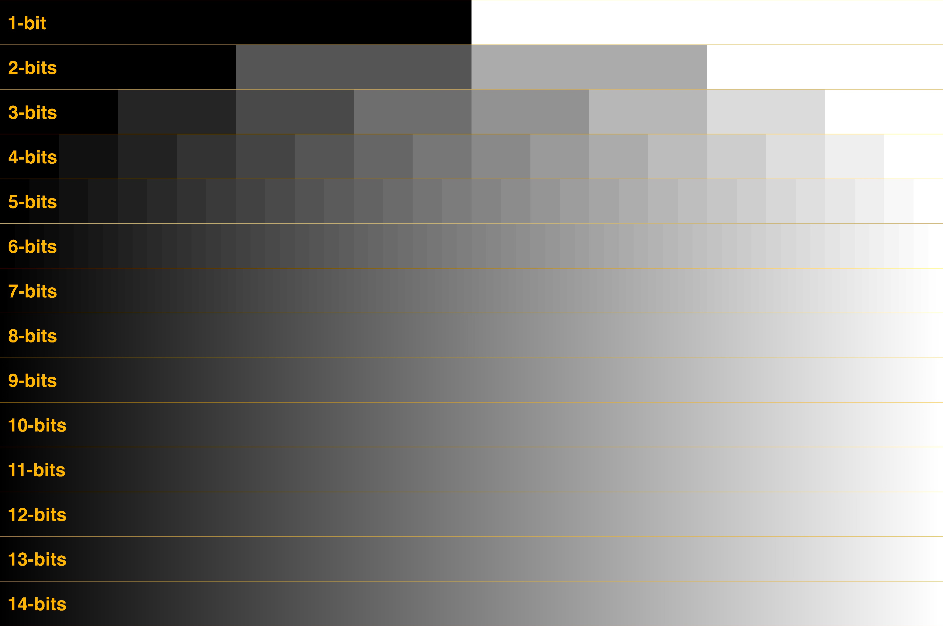
What is a pixel? Bit-depth(s)
8, 12, 14 vs 16-bit depth: What do you really need?! - Greg Benz Photography

Slide 6
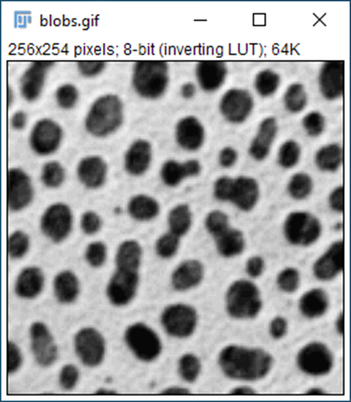
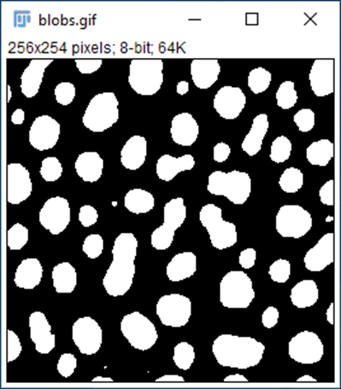
1-16 bit(s): Monochrome
Top: Raw image, 8-bits, intensity values – 0 – 255.
Bottom: Binary image, 1-bit*.
* - Fiji shows 8-bits since it’s the lowest bit depth for the image viewer.

Slide 7
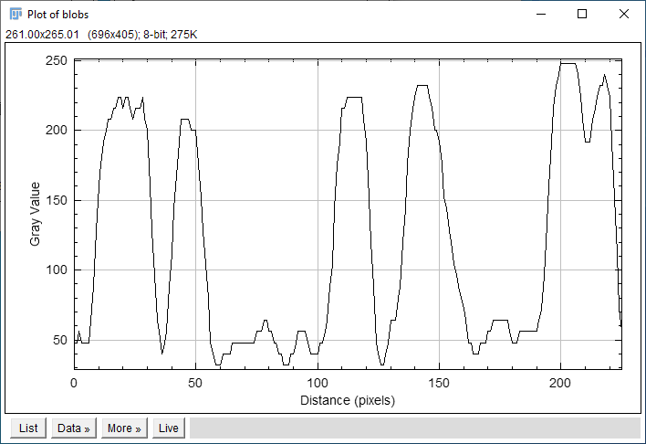
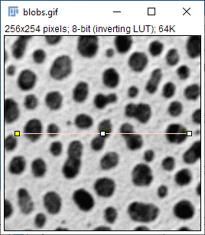
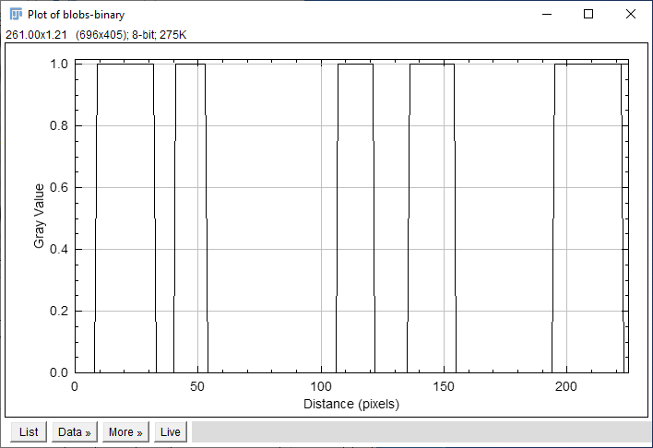
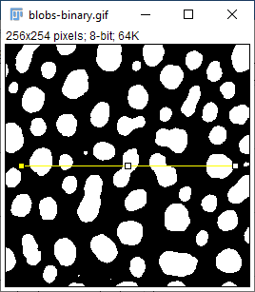
1-8 bit(s): Monochrome
Top: Raw image, 8-bits, intensity values – 0 – 255.
Bottom: Binary image, 1-bit*.
* - Fiji shows 8-bits since it’s the lowest bit depth for the image viewer.

Slide 8
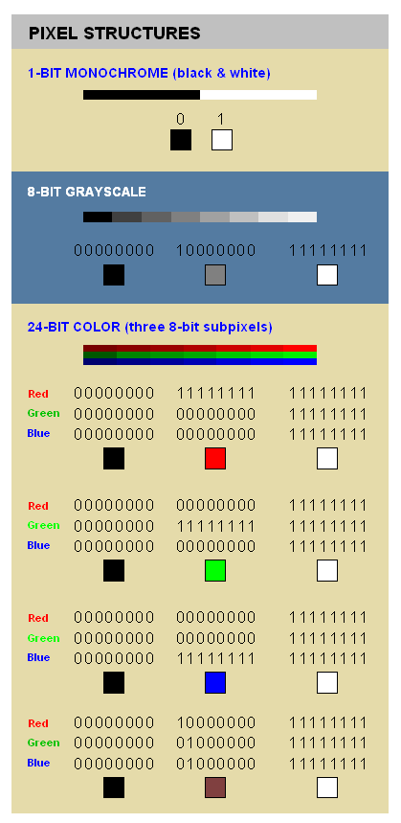


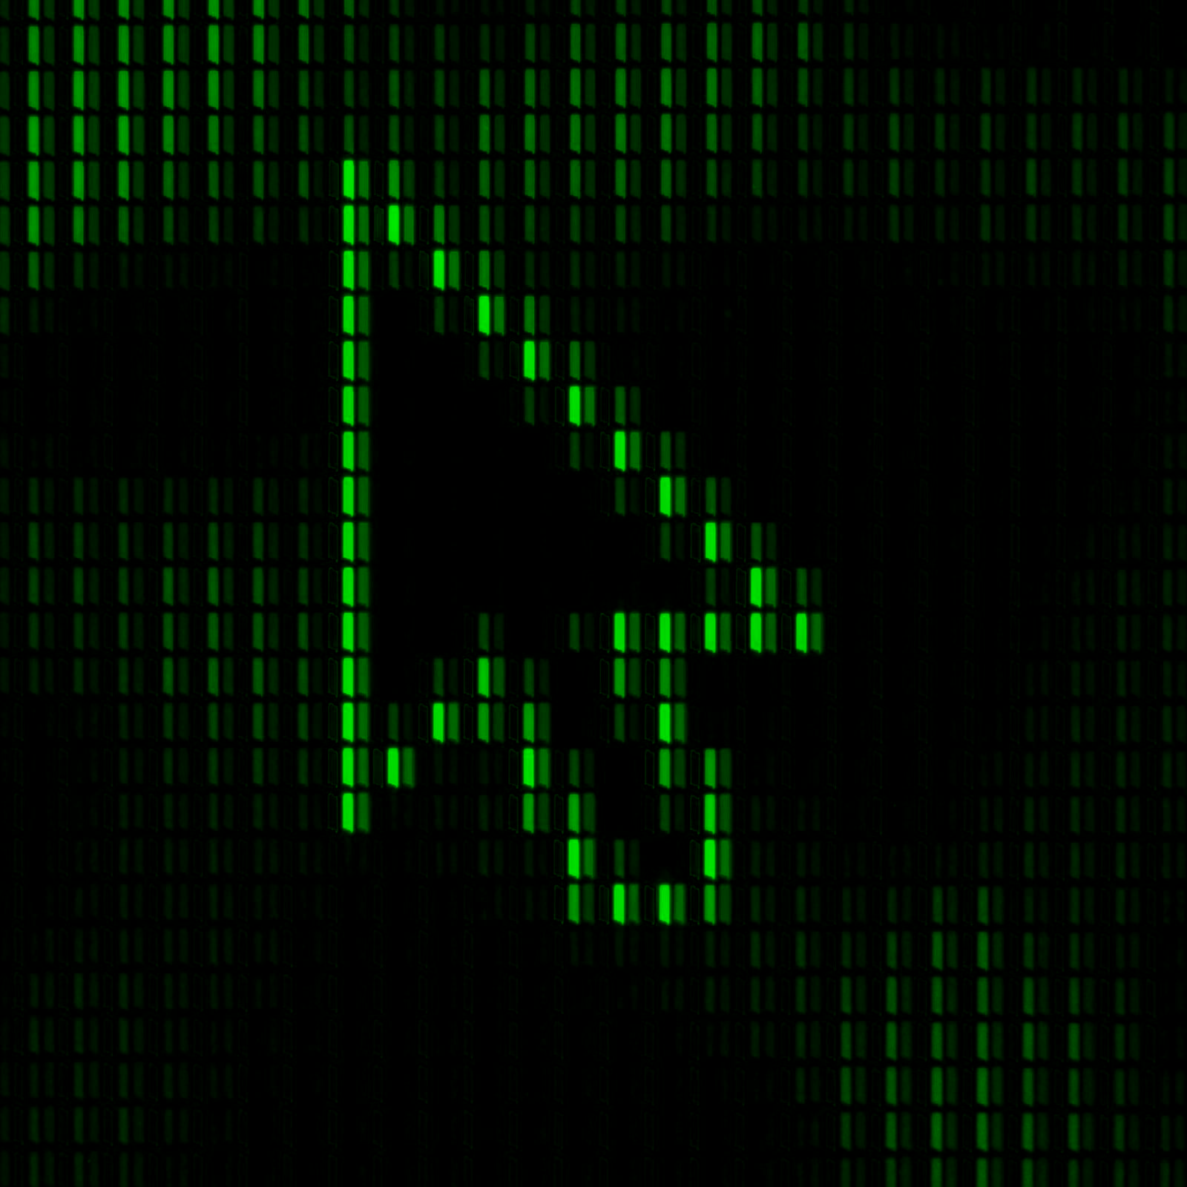




24 – (32) bits: RGB – (ARGB)
RED
GREEN
BLUE
Merge
8-bit
8-bit
8-bit
24-bit
https://encyclopedia2.thefreedictionary.com/8+bit+colour

Slide 9

ARGB – Alpha Red Green Blue – 32-bits
Alpha compositing. (2023, June 30). In Wikipedia. https://en.wikipedia.org/wiki/Alpha_compositing

Slide 10
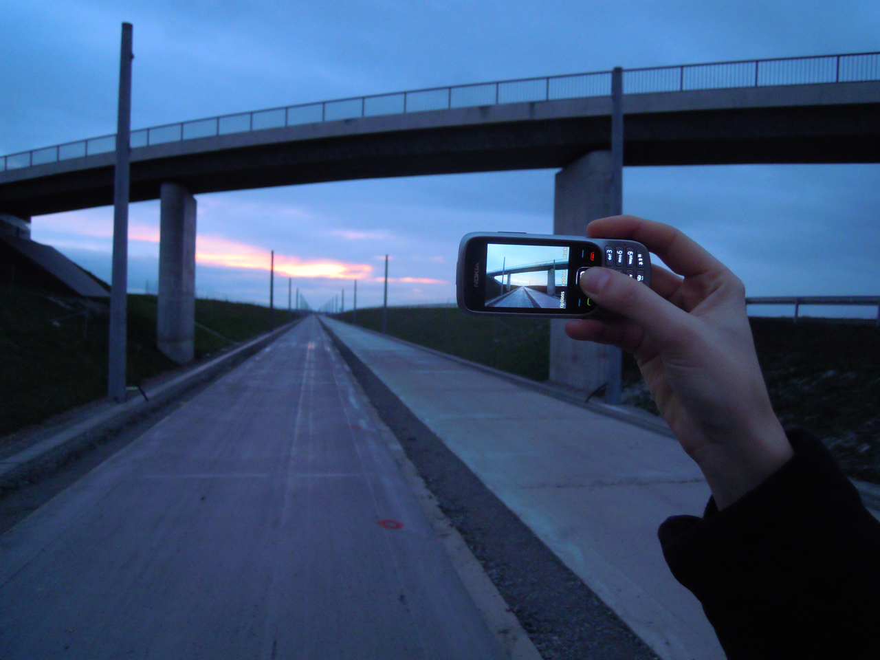

What is an image?
An image is a visual representation of something.
The act of making a 2D image with a mobile phone camera. The display of the mobile phone shows the image being made.
Image. (2023, July 18). In Wikipedia. https://en.wikipedia.org/wiki/Image

Slide 11
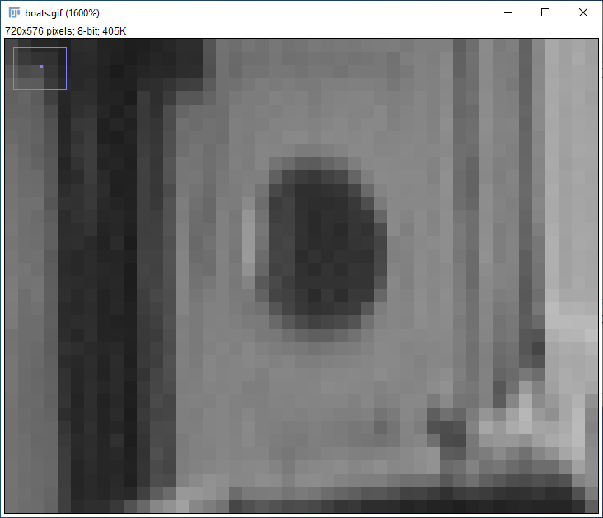
What is a digital image?
A digital image is an image composed of picture elements, also known as pixels, each with finite, discrete quantities of numeric representation for its intensity or gray level that is output from its two-dimensional functions fed as input by its spatial coordinates denoted with x, y on the x-axis and y-axis, respectively.^{[1]} Depending on whether the image resolution is fixed, it may be of vector or raster type. By itself, the term "digital image" usually refers to raster images or bitmapped images (as opposed to vector images).^{[citation needed]}
Digital image. (2023, June 30). In Wikipedia. https://en.wikipedia.org/wiki/Digital_image

Slide 12
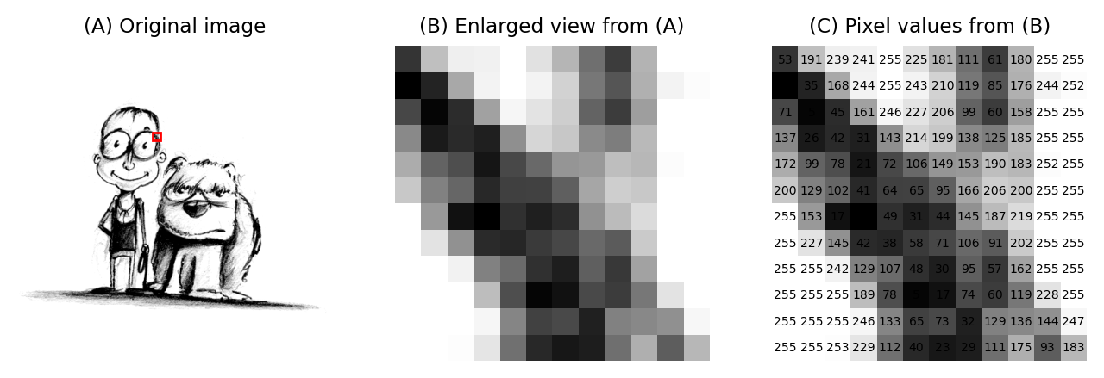
What is a digital image?
Images & pixels — Introduction to Bioimage Analysis (bioimagebook.github.io) - By Pete Bankhead

Slide 13
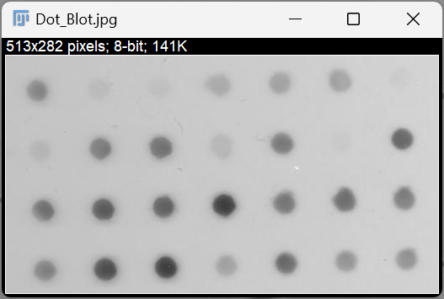
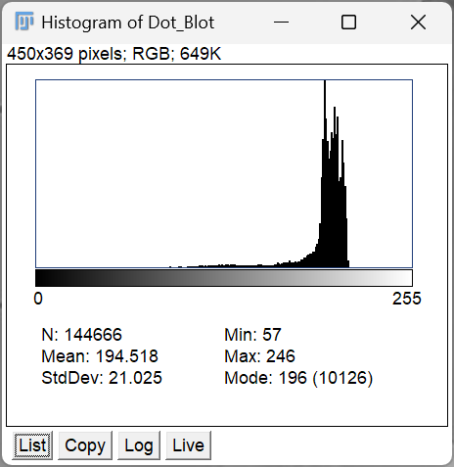
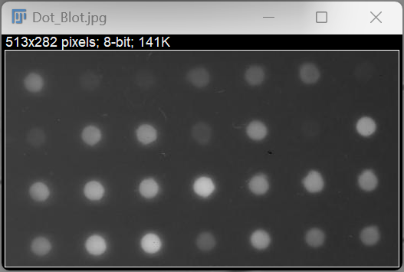
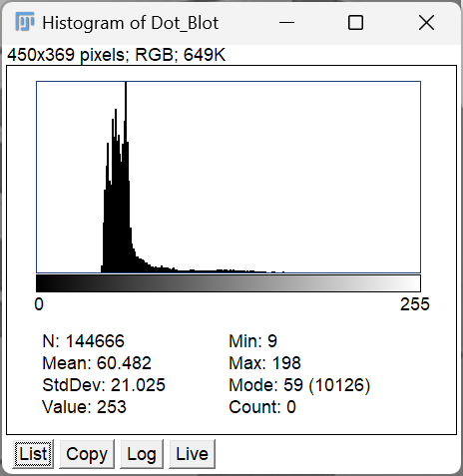
What is a digital image? Histograms
We can also invert the LUT, and emphasize desired objects.

Slide 14
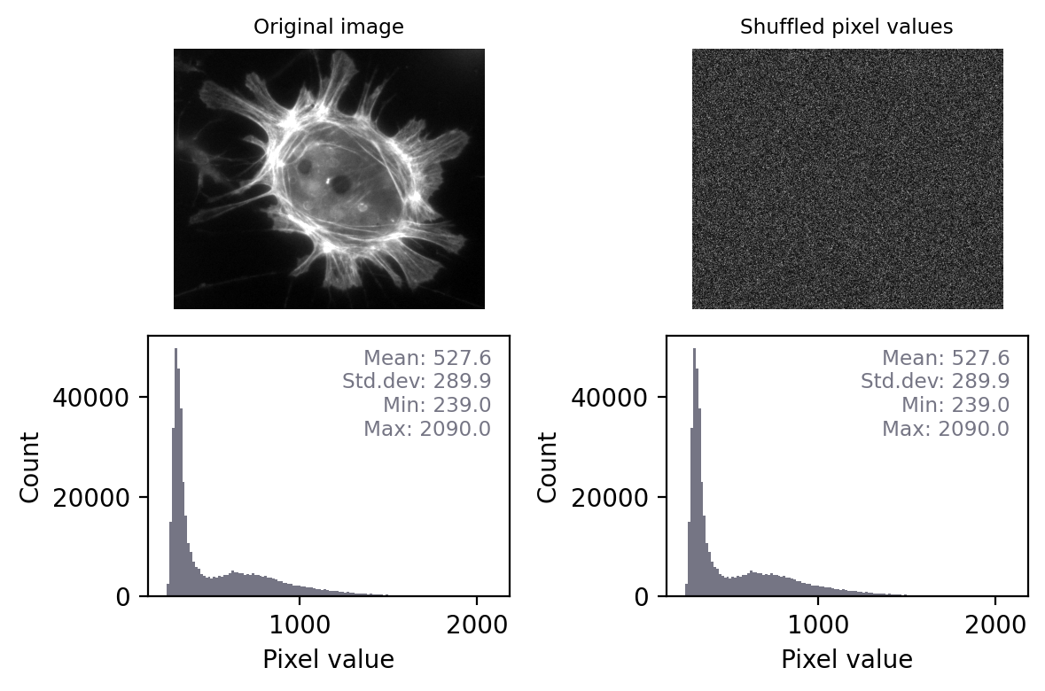
What is a digital image? Histograms
If two images have identical histograms and summary statistics (mean, min, max, standard deviation), does this prove that the images are identical?
https://bioimagebook.github.io/chapters/1-concepts/2-measurements/measurements.html

Slide 15
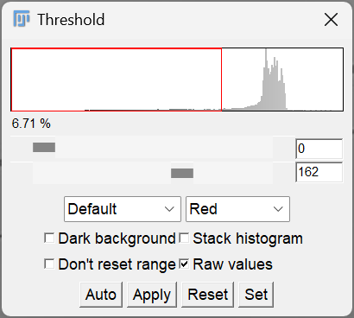
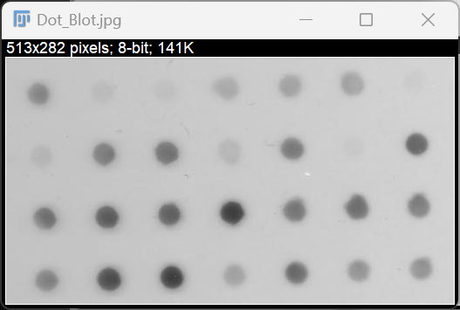
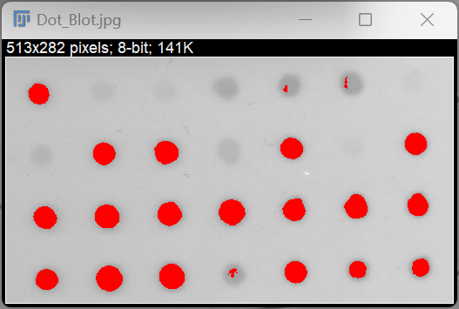
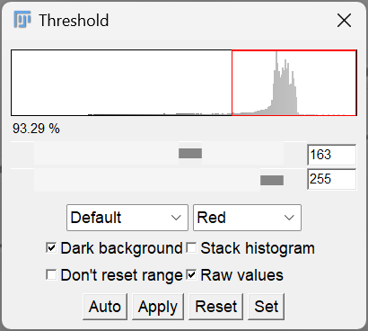
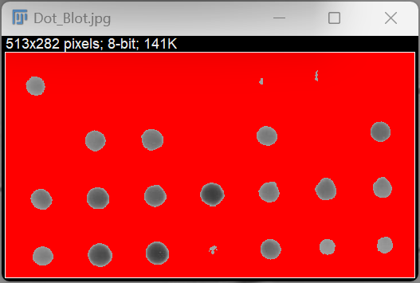
Histograms - a tool to find objects

Slide 16
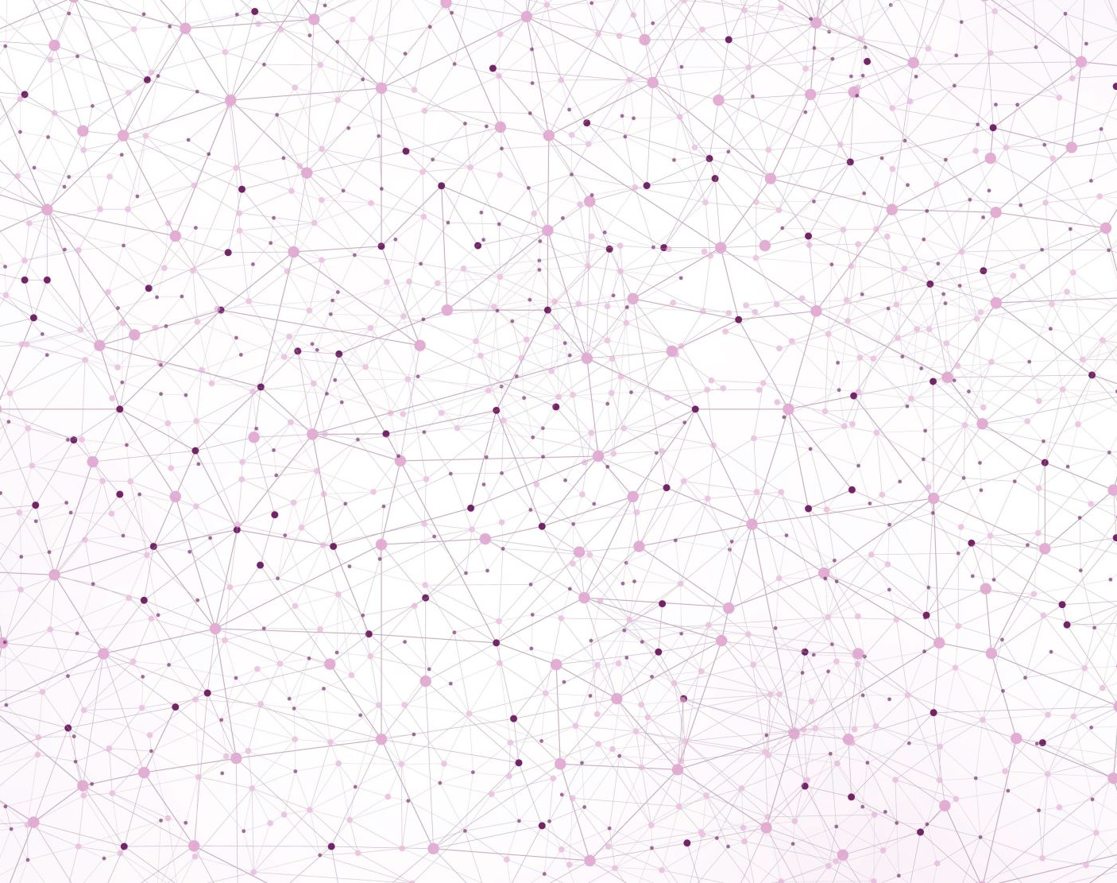
Basics of Image Processing

Slide 17
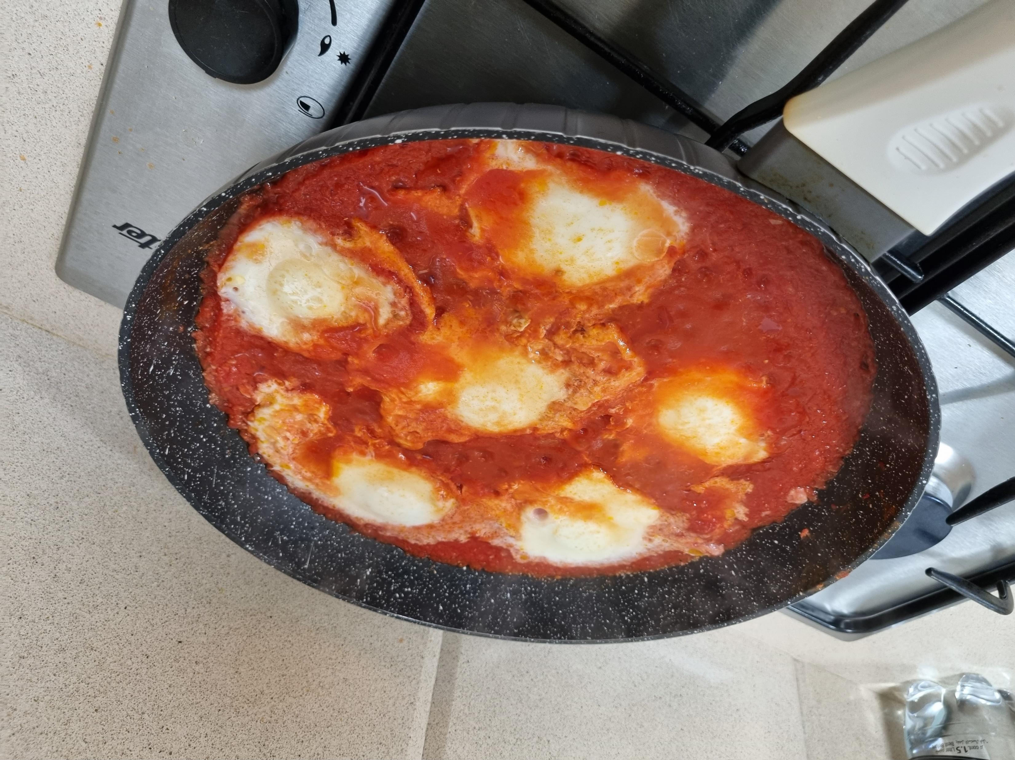
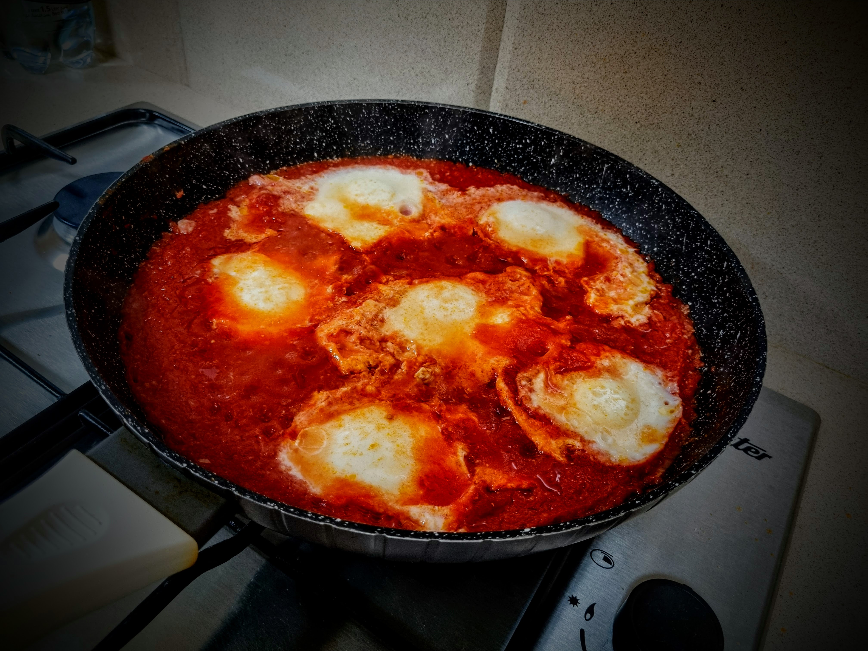

What is image processing?
In general– it is whatever manipulation you do on the raw image to achieve a certain desired aesthetic.
But…
This workflow belongs to the catering business!
Notes:
At the simplest level, image processing involves altering a raw picture to achieve a desired appearance. In our case, we accomplish this by modifying the pixel values of the image, resulting in a new image. This newly created image holds valuable information such as object shapes, the original picture's brightness, and labeled images.

Slide 18
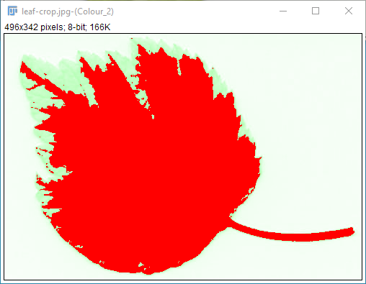
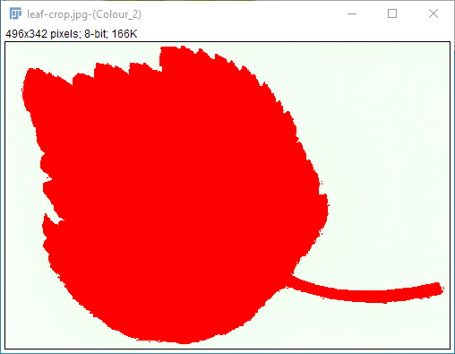
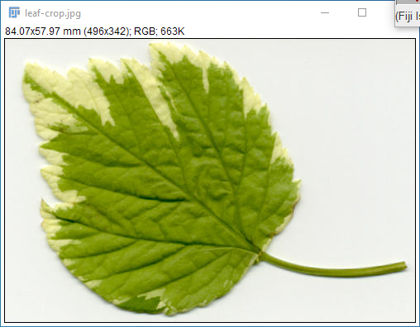
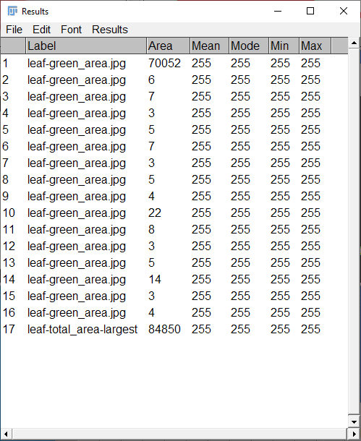
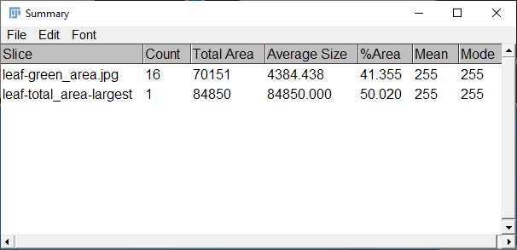
Image Analysis Is (Usually) The Aftermath Of A Processing Workflow- That Enables Us To Conclude Our Experiment

Slide 19
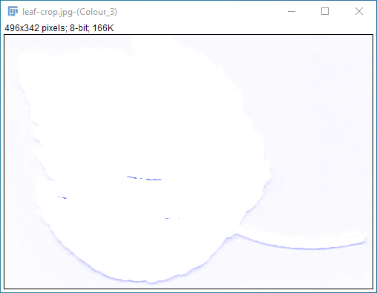
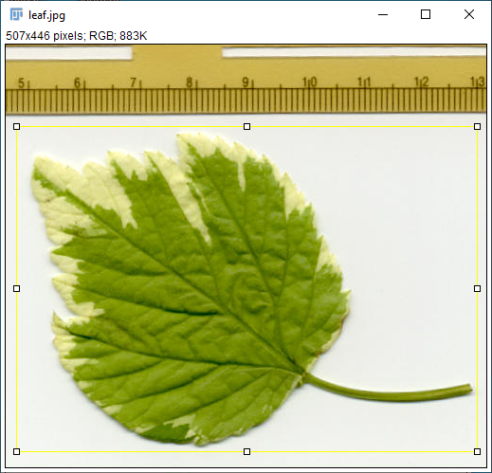
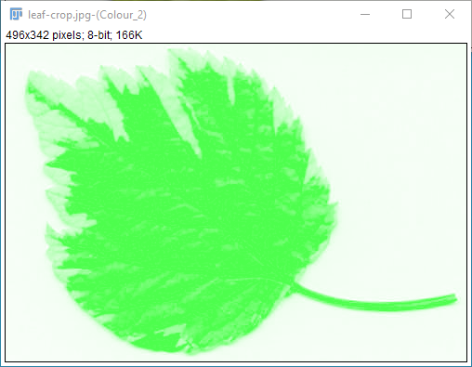
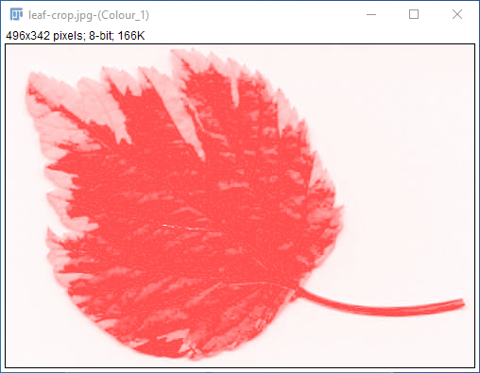
What is image processing?
In our context – the raw data (pixel values) is altered to give an intermediate/result image, from which we extract meaningful data at the analysis part, e.g., shape parameters, area, intensity values (of the raw image), label images, etc.

Slide 20
What Is Image Processing? – Comparative Summary
While artistic image processing is more concerned with the overall appearance of an image. In contrast, scientific image processing is more concerned with the quantitative information that can be extracted from an image.
However, there is some overlap between the two fields, as some artistic image-processing techniques can also be used for scientific purposes. For example, adjusting the brightness and contrast of an image can be used to improve the visibility of objects in an image, which can be useful for scientific image processing tasks such as object identification.
Feature | Artistic Image Processing | Scientific Image Processing
Purpose | Enhance the aesthetic appeal of an image | Extract information from an image
Subjectivity | Subjective | Objective
Examples | Adjusting brightness, contrast, and color balance; removing noise and artifacts | Identifying objects, measuring size and shape, tracking movement
Notes:
Artistic image processing is the use of image processing techniques to enhance the aesthetic appeal of an image. This can involve tasks such as adjusting the brightness, contrast, and color balance of an image, as well as removing noise and artifacts. Artistic image processing is often subjective, as there is no one "correct" way to enhance an image. The goal is to create an image that is visually pleasing to the viewer.
Scientific image processing is the use of image processing techniques to extract information from an image. This can involve tasks such as identifying objects in an image, measuring the size and shape of objects, and tracking the movement of objects over time. Scientific image processing is often more objective than artistic image processing, as the goal is to extract quantitative information from an image.

Slide 21
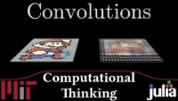

Slide 22
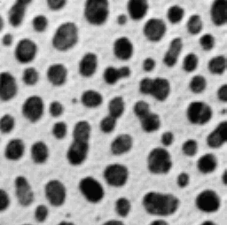

Example – Gaussian Blur
Raw
Gaussian Blur, sigma = 4
haesleinhuepf/imagejmacromarkdown: Generate markdown notebooks from ImageJ Macro (github.com)
imagejmacromarkdown/src/main/macro/first_test.ijm at master · haesleinhuepf/imagejmacromarkdown (github.com)
Notes:
In the context of image processing with Fiji, "sigma" is a parameter often used in Gaussian filtering and other similar operations.
Fiji is an open-source platform for biological-image analysis that supports a wide range of processing techniques. It's an expanded version of ImageJ, which is another popular tool for similar purposes.
In the context of a Gaussian filter, the sigma parameter is used to define the standard deviation for the Gaussian distribution. Essentially, it controls the degree to which the filter blurs the image.
Here's why it matters:
- A larger sigma implies a wider distribution and thus more blurring because the influence of a given pixel on its neighbors decreases more slowly.
- Conversely, a smaller sigma implies a narrower distribution, so the filter does less blurring because a pixel's influence decreases more quickly.
Remember that the sigma value should always be a positive number. It is important to choose an appropriate sigma for your specific task, as the amount of blurring can significantly affect subsequent image processing operations.

Slide 23

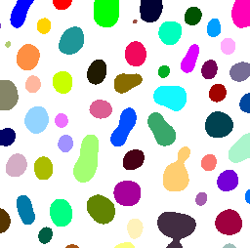
Example – Gaussian Blur – as a tool for segmentation
imagejmacromarkdown/src/main/macro/first_test.ijm at master · haesleinhuepf/imagejmacromarkdown (github.com)

Slide 24
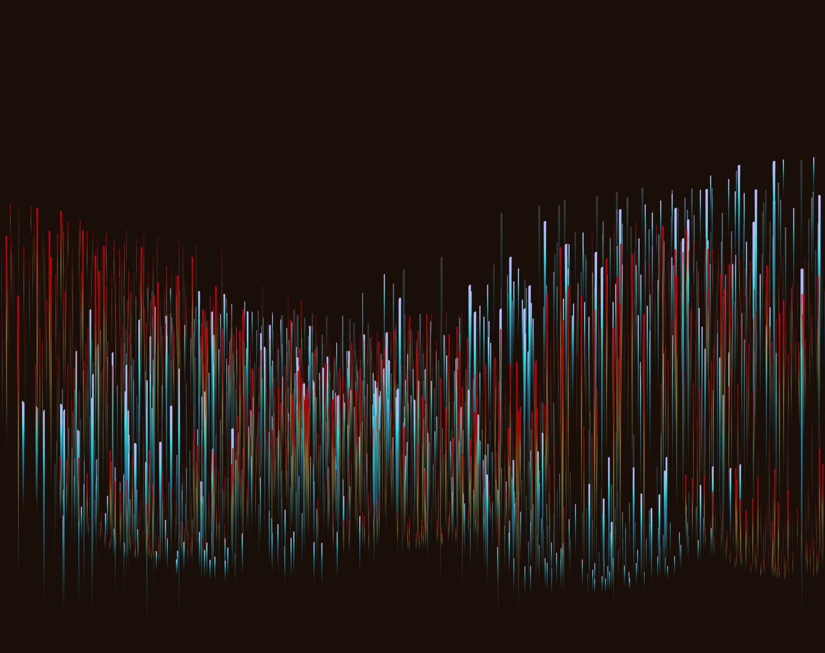
Hands-on Demo: Exploring Image Properties in Fiji

Slide 25
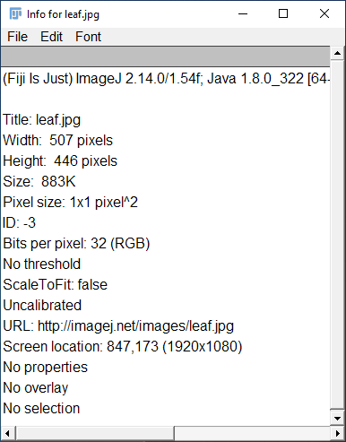


Slide 26
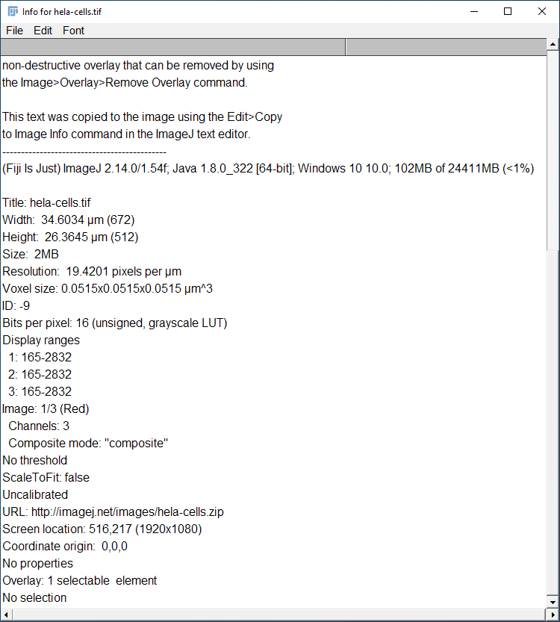
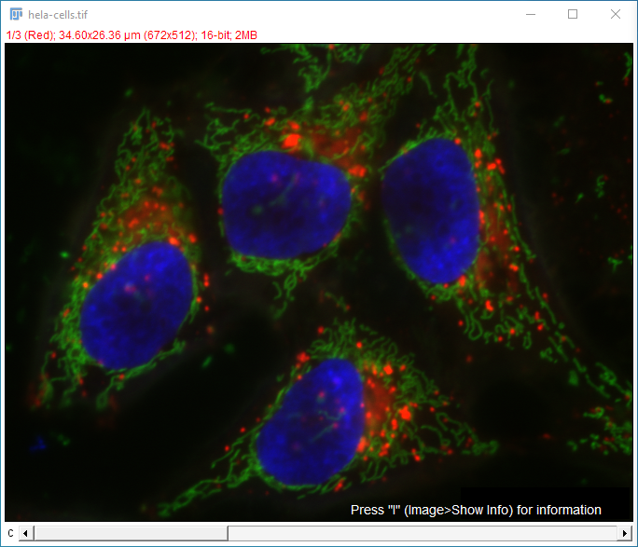

Slide 27
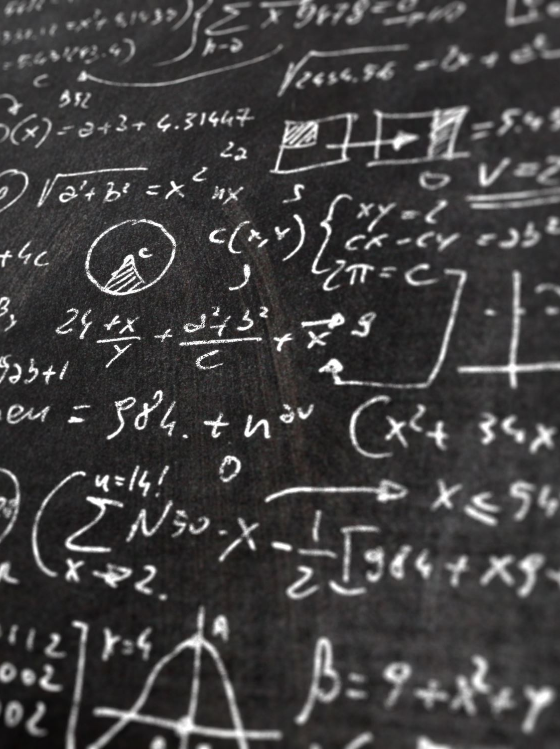
Basic Image Processing Techniques

Slide 28
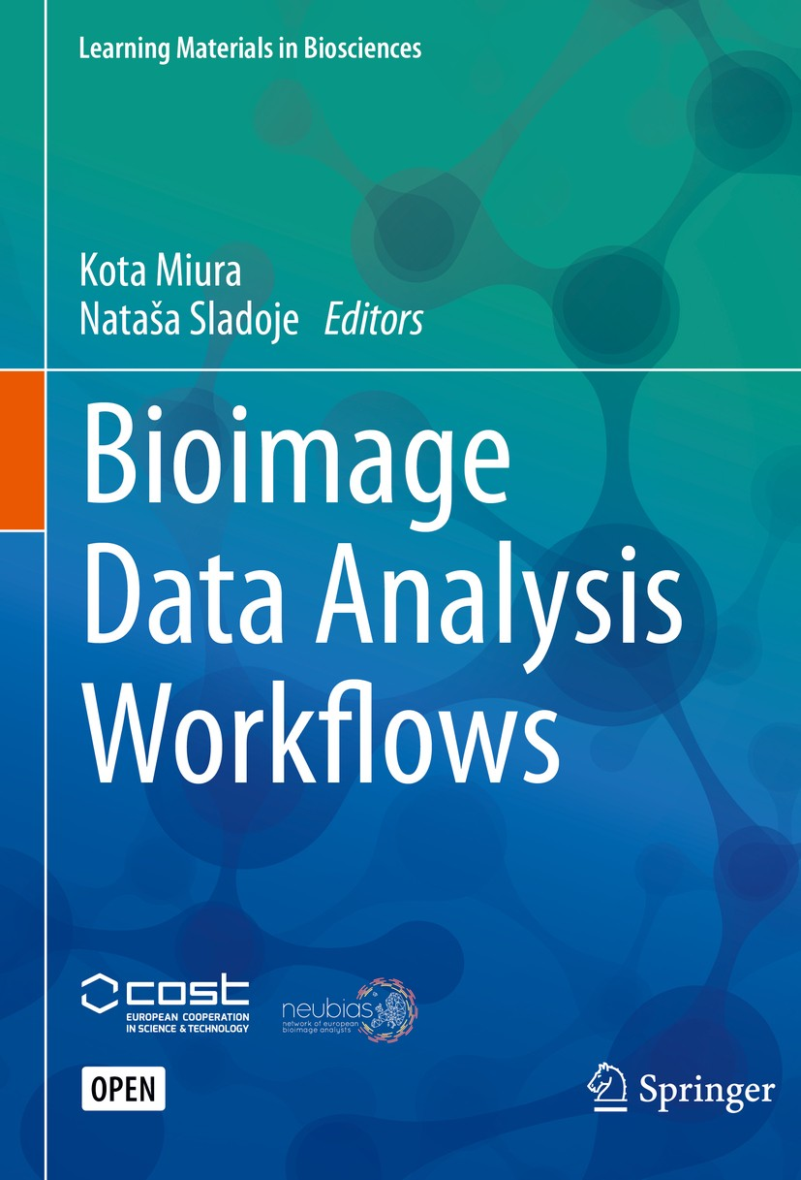
Bioimage Data Analysis Workflows
Bioimage Data Analysis Workflows | SpringerLink

Slide 29
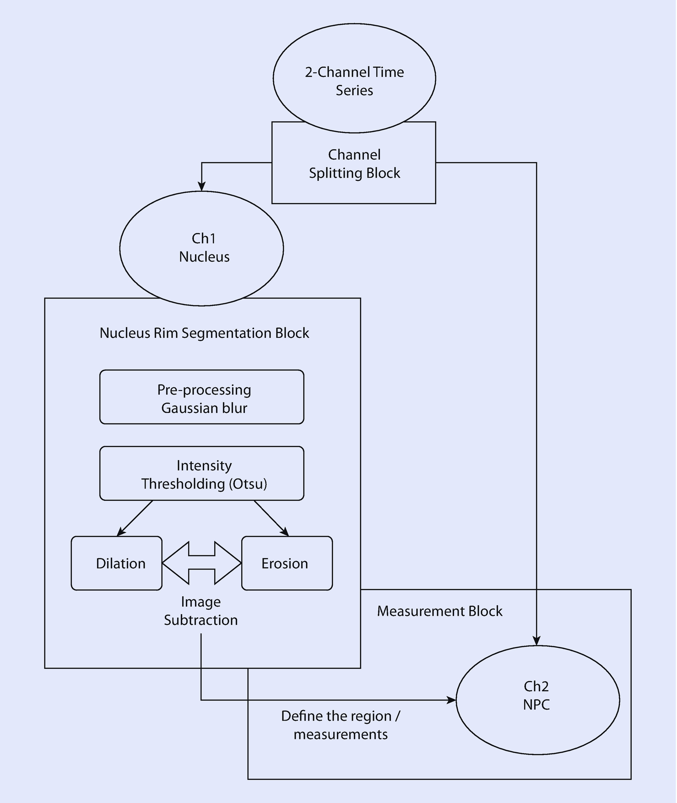
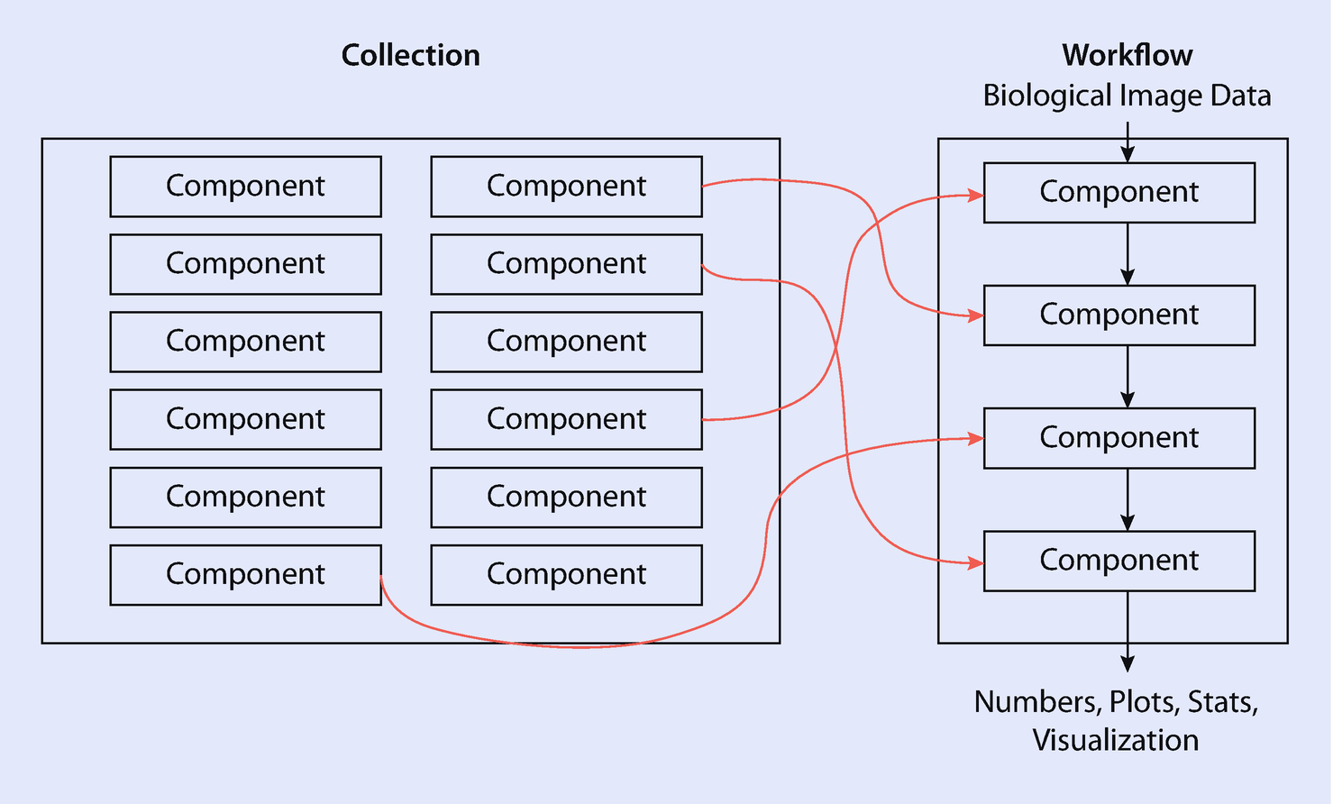
Bioimage Data Analysis Workflows
“…Each workflow is uniquely associated with a specific biological research project because the question asked therein as well as the acquired image quality are often unique. This calls for a unique combination of components and parameter set. Some collections, especially those designed with GUI, offer workflow templates…”
Workflows and Components of Bioimage Analysis | SpringerLink
Figure 2 | Measurements of Intensity Dynamics at the Periphery of the Nucleus | SpringerLink

Slide 30

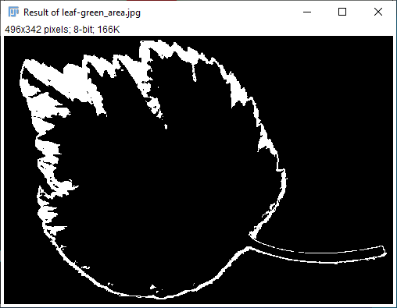
Example Workflow – Green vs. Pale Area of A Leaf
Fiji: ImageJ, with "Batteries Included"
Notes:
Crop the original image
Color Decon.
Threshold 1: Green area
Analyze Particles
Threshold 2: Total Area
Analyze Particles
Calculate Ratio: Green/Total Area

Slide 31

Break (10 minutes)

Slide 32
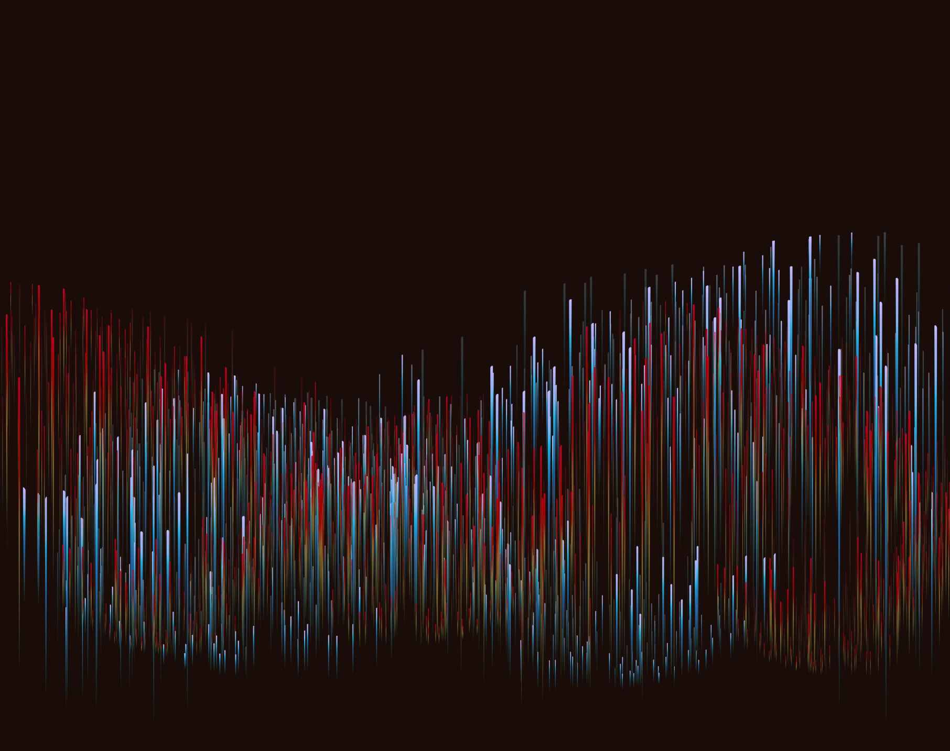
Hands-on Demo: Fiji Basics

Slide 33
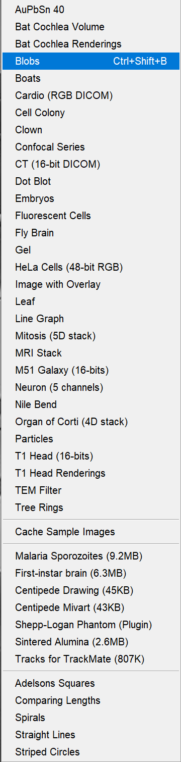
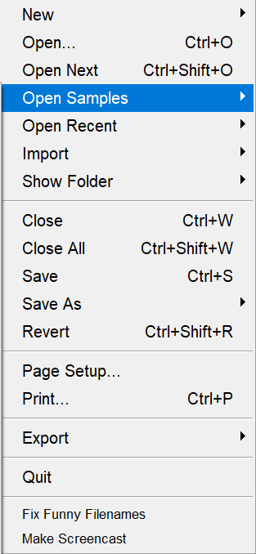
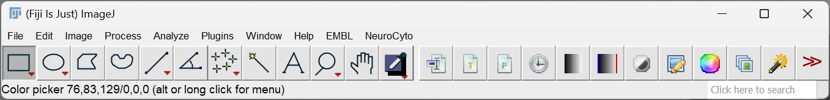


Opening images
Fiji: ImageJ, with "Batteries Included"
Image→Properties…
Shortcut: < i >

Slide 34
Opening images
Fiji: ImageJ, with "Batteries Included"
Image→Properties…
Shortcut: < i >

Slide 35


Smoothing Images
Fiji: ImageJ, with "Batteries Included"
Process → Filters → Gaussian Blur…

Slide 36



Regions Of Interest (ROIs) And The ROI Manager– Free Hand Selection
Fiji: ImageJ, with "Batteries Included"
To add a ROI to the manager, click < t >

Slide 37











Connected components analysis
Adjust → Threshold
Analyze → Set Measurements…
Analyze → Analyze Particles…

Slide 38
Example Workflow – Green vs. Pale Area of A Leaf*
Fiji: ImageJ, with "Batteries Included"
* - Morpho Lib J is used in this workflow
Notes:
Crop the original image
Color Decon.
Threshold 1: Green area
Analyze Particles
Threshold 2: Total Area
Analyze Particles
Calculate Ratio: Green/Total Area

Slide 39


Update Sites: Plugin Installation

Slide 40

A message from our sponsors
Image analysis is not thought in Hogwarts, and thus, it’s not magic making.
SHIT IN == SHIT OUT
Dedicate the time for proper sample preparation. The analysis is a part of the experiment, and good quality images, provide high quality conclusions.
Thank You

Slide 41

Q&A and Feedback

